Slide 1
Land Change Detection using Deep Learning Jefferson Roesler

Slide 2
Project Overview
Objective: Detect Land Cover changes using satellite imagery
Approach: Use a ResNet-based neural network for feature extraction and classification
Motivation: Monitoring land use changes for urban planning, environmental conservation, and property tax assessment

Slide 3
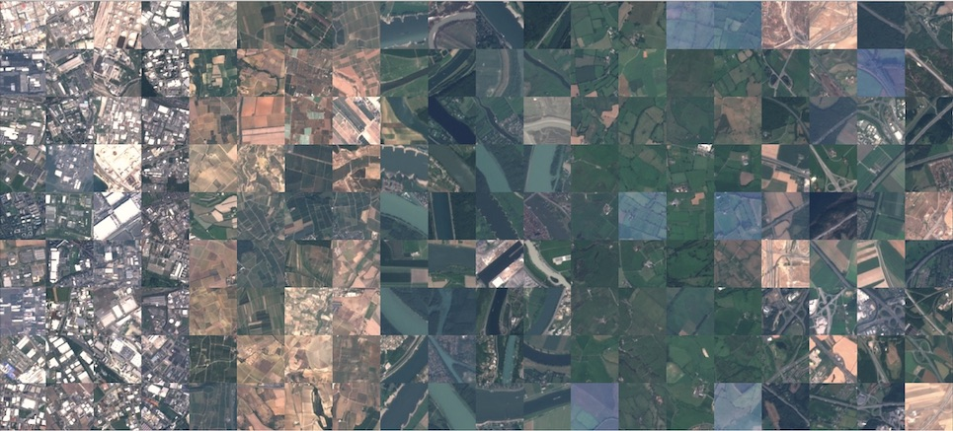
Dataset
EuroSat Dataset with 13-band satellite images
Classes: Categories like Forest, Residential, Industrial, Highway, Permanent crops, etc. (10 classes total)

Slide 4
Model Architecture
ResNet Feature Extractor | Pre-Trained ResNet 18 Model | Modified to accept 13-channel output
Change Detection Mechanism | Computes absolute differences between features of image pairs
Classification | Two fully connected layers for classification

Slide 5
Training and Validation
Loss Function: Cross-entropy loss
Optimizer: Adam (LR 0.001)
Epochs: 10
The model achieves a test accuracy of 97%,
indicating good performance.

Slide 6
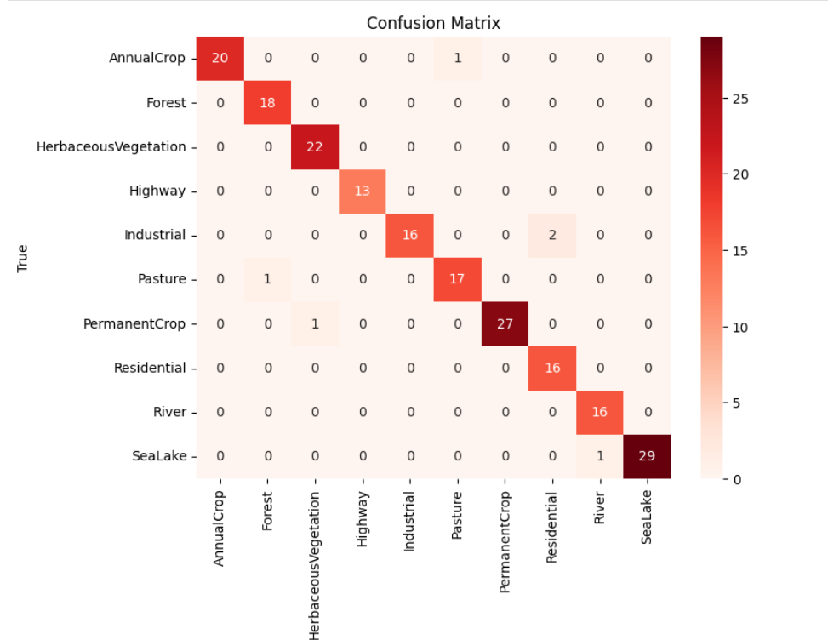
Confusion Matrix

Slide 7
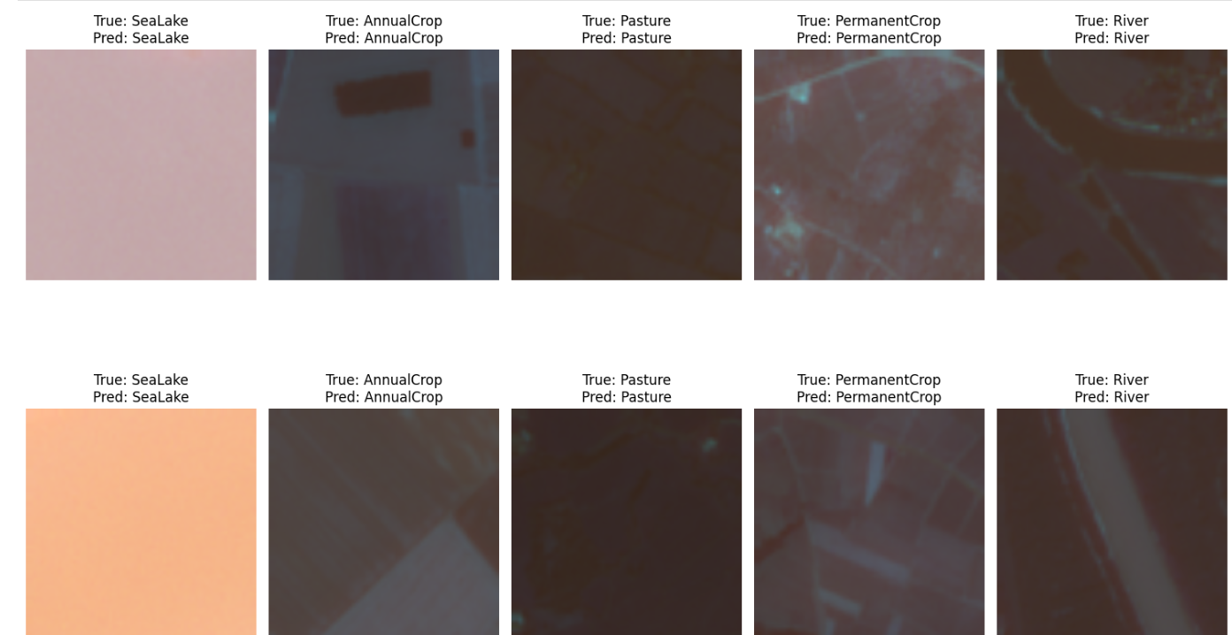
Predictions

Slide 8
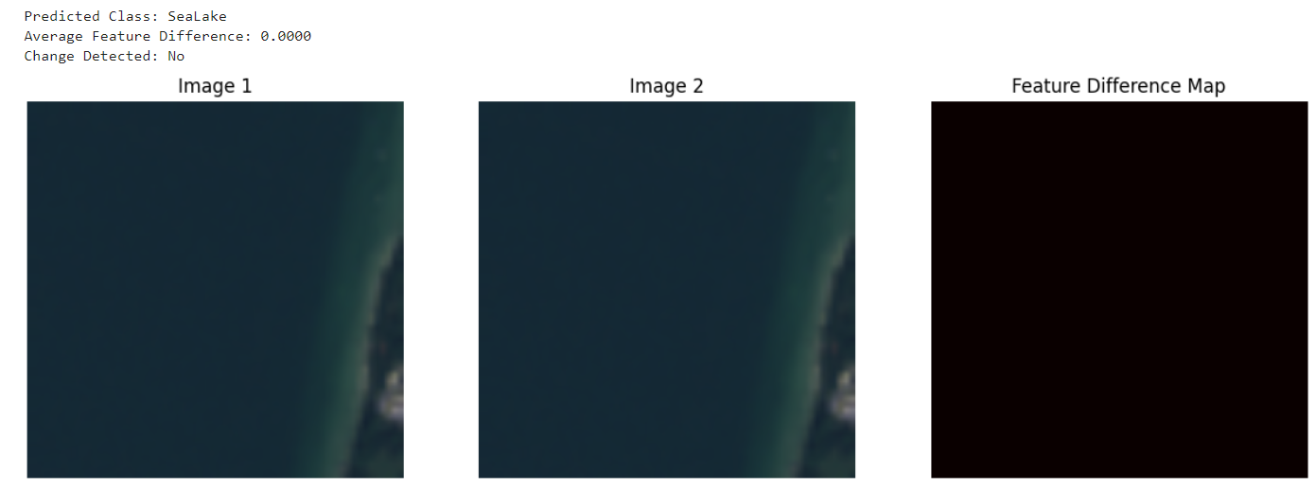
Change Detection (Same image as an example)

Slide 9
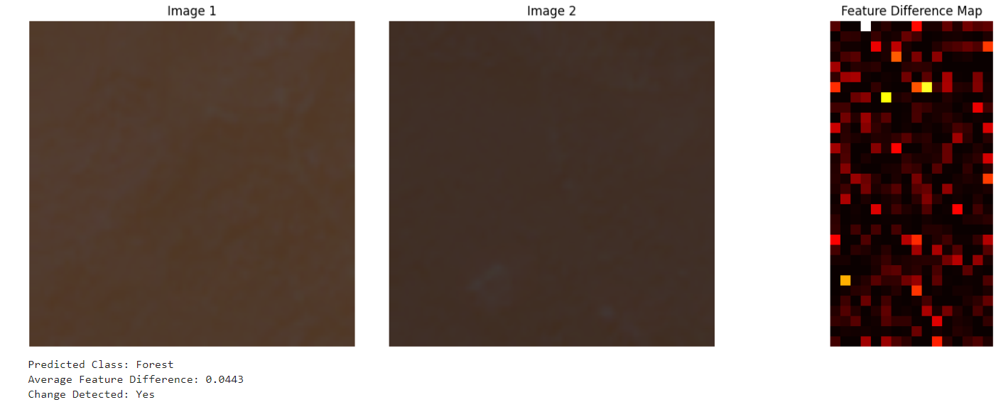
Change Detection (Simple Model vs ResNet Model)

Slide 10
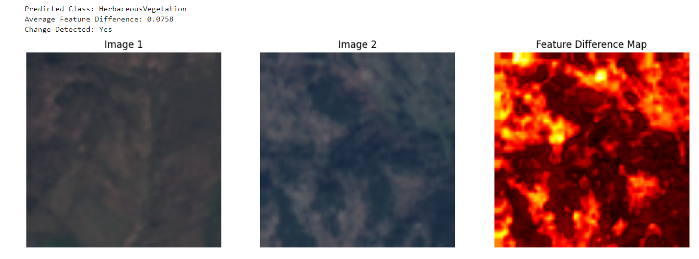
Change Detection (Simple Model vs ResNet Model)

Slide 11
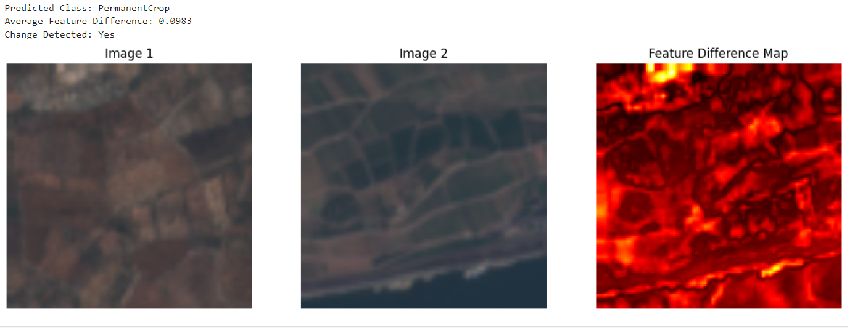
Change Detection (Simple Model vs ResNet Model)

Slide 12
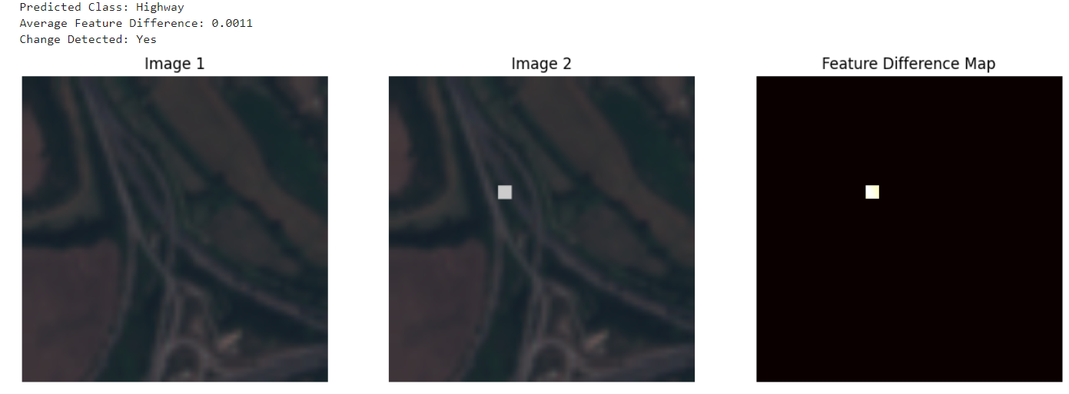
Simulation of Construction
Inserted a small rectangle simulating a construction.

Slide 13
Future works
Integration with Google Maps API
Integration with Geographic Information Systems (GIS)
Temporal Analysis

